Slide 1
Component-Level Design

Slide 2
Design a class
Purpose: Design the class to fulfill its role in use-case realizations and the nonfunctional requirements that apply to it.
Define operations, attributes, methods, relationships, states, dependencies to any generic design mechanisms, and requirements relevant to its implementation and correct realization of any interface that it is required to provide.

Slide 3
Steps:
Outline the design class.
Identify operations.
Identify attributes.
Identify associations and aggregations.
Identify generalizations
Describe methods
Describe states
Handle special requirements

Slide 4
類別圖：符號(續)
關係：
聯合(association)：雙向 ，單向
依賴(dependency)：
特殊關聯：
聚合(aggregation)：by ref ，
組合(composition)：by value
繼承(generalization)：繼承類別
多重性(multiplicity)：*, 0, 1, 0..*, 1..*, etc.

Slide 5
關係的互通性
在關聯關係的互通性(Navigability)中，沒有箭頭的直線代表著彼此雙方都可以互通訊息。
當希望表達訊息的傳遞是單向的，則可用只帶有單方向箭頭的直線來繪製此概念。
例如，一個訂單可以有許多訂購項目。
給定一個訂單，我們可以找出訂購項目
但訂購項目不需要知道它是屬於哪個訂單，此種情況可以modeling如圖所示。
訂單
訂購項目

Slide 6
相依關係的符號
相依關係的符號表法是用一條帶有箭頭的虛線來表示，其箭頭是由使用類別指向被使用類別，如圖顯示出類別A(ClassA)相依於類別B(ClassB)。
ClassA
ClassB

Slide 7
相依關係與關聯關係
從相依關係的定義來看，它說的是一個類別呼叫了另一個類別的操作
從關聯關係的結構上來看，如果類別A與類別B互相有關聯，那麼類別A當然有辦法可以呼叫類別B的操作，不是嗎？那麼我們可不可以說關聯關係是相依關係的一種呢？答案是可以的。
關聯關係表達出類別之間的強耦合度。
相依關係表達出類別之間的弱耦合度。

Slide 8
耦合度
相依關係表達出類別之間的弱耦合度。關聯關係依其結合的程度(Degree of Coupling)而分為不同形式的關聯關係。
所謂的結合度是用來量度兩個物件(類別)之間的依賴程度，又稱為耦合度。
高耦合度：當參與關係的兩個物件彼此依靠，無法單獨存在時稱之。
低耦合度：如果一個物件可以獨立存在，但是如果沒有另一個物件的幫忙「某些」事項會無法完成時稱之。
零耦合度：如果兩個物件互不溝通，也沒有必要分享資料時稱之。

Slide 9
聚合
聚合(Aggregation)是一種特殊的關聯關係，它是用以表達「整體和部份」的關係，它也隱含著所謂包含(Include)的關係。
因此，聚合的關係可以用英文的“is-part-of”，“has-a”或是“has-parts”語意上的關係來表示。
換言之，聚合的關係不只是指出物件相互了解的關係，更是它們被組合起來以形成一個新的更複雜的物件。
聚合關係以一個空的菱形來表示代表整體的一方。
一個球隊有球員，球隊如果沒了，球員還可以到別的球隊打球(聚合)。
球隊
球員

Slide 10
組合
組合(Composition)關係是一種比聚合關係更強的包含關係。
在一個聚合的關係中，如果整體的消失會造成部分(Parts)的消失，那麼這個聚合是一種組合關係。
組合關係以一個實心的菱形來表示代表整體的一方。
一本書包含有很多章節，如果書沒了，章節也就沒了(組合)
書
章

Slide 11
關係的強弱
Association (關聯)
Aggregation(聚合)
Composition(組合)

Slide 12
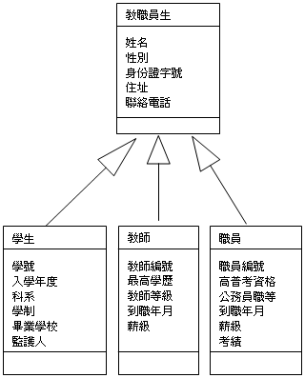
類別圖範例：繼承

Slide 13
OO Component

Slide 14
Outline the design class.
Input: analysis classes and/or interfaces
Designing boundary class is dependent on the specific interface technologies in use. Ex: GUI tool or library.
Designing entity classes that represent persistent information implies using a specific database technology.
Designing control class should consider following needs:
Distribution issues: Separate design classes on different nodes might be required to realize the control class.
Performance issues: The control class could be realized by the same design class that are realizing some related boundary and/or entity class.
Transaction issues: transaction management technology.

Slide 15
Identify operations
The operations of a design class should support all the roles that the class plays in different use-case realization.
The operations are described by using the syntax of programming language.
Inputs:
Responsibilities of the analysis class that the design class traces to.
The special requirements of the analysis class that the design class traces to.
The interface(s) that the design class needs to provide.
The use-case realizations—design in which the class participates.

Slide 16
Identify attributes
An attribute specifies a property of a design class that is often implied and required by the operations of the class.
Guidelines when the attributes are identified:
Attribute of the analysis class that the design class traces to often implies one or several attributes of the design class.
The available attribute types are restricted by the programming language.
If a design class becomes too complicated to understand because of its attributes, some of these attributes may be separated into classes of their own.
If there are many or complex attributes of a class, illustrate this in a separate diagram that shows only the attribute compartment.

Slide 17
Identify associations and aggregations
Associations can be found from the message transmissions in the interaction diagram.
Guidelines when associations and aggregations are identified:
Consider the associations or aggregations involving the corresponding analysis class, these relationships may imply the need for one or several corresponding relationships that involve the design class.
Refine association multiplicities, role names, association classes, roles
Refine the navigability of associations.

Slide 18
Describe methods
Methods are used to specified how operations are realized.
Methods can be specified using natural language or pseudo-code.
If methods are simple, it can be implemented directly during implementation stage.

Slide 19
Describe states
Some design objects are state controlled, meaning that their state determines their behavior when they receive a message.
Use state-chart diagram to describe the different state transitions of state-controlled design object.

Slide 20
狀態圖範例
開始(start)
/get first item
有些項目已經檢查完
/get next item
所有項目已檢驗查過＆＆
所有的項目都有庫存
Checking(檢查中)
Do/check
item
Dispatching(發送中)
Do/initiate
delivery
Item Received
所有的項目都有庫存
所有項目已經檢查過＆＆
一些項目 沒有庫存
Delivered
活動
(activity)
Item Received
有些項目沒有庫存
Waiting
(等待中)
Delivered
(已傳送)
轉換(transition)
自身轉換(self-transition)
狀態(State)

Slide 21
Activity Diagram

Slide 22
Design a subsystem
Purposes:
Ensure that the subsystem is as independent as possible of other subsystems and/or their interface,
Ensure that the subsystem provides the right interfaces,
Ensure that the subsystem fulfills its purpose in that it offers a correct realization of the operations as defined by the interfaces it provides.

Slide 23
User Interface Design

Slide 24
Interface Design
Easy to learn?
Easy to use?
Easy to understand?

Slide 25
Interface Design
Typical Design Errors
lack of consistency
too much memorization
no guidance / help
no context sensitivity
poor response
Arcane/unfriendly

Slide 26
Golden Rules
Place the user in control
Reduce the user’s memory load
Make the interface consistent

Slide 27
Place the User in Control
Define interaction modes in a way that does not force a user into unnecessary or undesired actions.
Provide for flexible interaction.
Allow user interaction to be interruptible and undoable.
Streamline interaction as skill levels advance and allow the interaction to be customized.
Hide technical internals from the user.

Slide 28
Reduce the User’s Memory Load
Reduce demand on short-term memory. (免於記憶)
Establish meaningful defaults. (有用預設值)
Define shortcuts that are intuitive. (直觀快捷)
The visual layout of the interface should be based on a real world metaphor. (視覺設計與現實認知吻合)
Disclose information in a progressive fashion. (漸進式訊息)

Slide 29
Make the Interface Consistent
Allow the user to put the current task into a meaningful context.
Maintain consistency across a family of applications.
If past interactive models have created user expectations, do not make changes unless there is a compelling reason to do so.

Slide 30
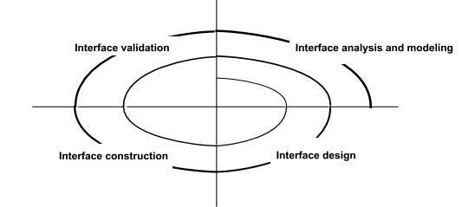
User Interface Design Process

Slide 31
User Analysis
Are users trained professionals, technician, clerical, or manufacturing workers? (使用者背景)
What level of formal education does the average user have? (教育程度)
Are the users capable of learning from written materials or have they expressed a desire for classroom training? (閱讀能力)
Are users expert typists or keyboard phobic? (操作能力)
What is the age range of the user community? (年齡)
Will the users be represented predominately by one gender? (性別)
Do users work normal office hours or do they work until the job is done? (工作場域)
Is the software to be an integral part of the work users do or will it be used only occasionally? (使用情境)
What is the primary spoken language among users? (慣用語系)
What are the consequences if a user makes a mistake using the system? (異常處理)
Do users want to know about the technology the sits behind the interface? (技術掌握)

Slide 32
Interface Analysis
Interface analysis means understanding
(1) the people (end-users) who will interact with the system through the interface; (誰會用?)
(2) the tasks that end-users must perform to do their work, (為何用?)
(3) the content that is presented as part of the interface (如何用?)
(4) the environment in which these tasks will be conducted. (哪種場域使用?)

Slide 33
Interface Design Steps
Using information developed during interface analysis, define interface objects and actions (operations).
Define events (user actions) that will cause the state of the user interface to change. Model this behavior.
Depict each interface state as it will actually look to the end-user.
Indicate how the user interprets the state of the system from information provided through the interface.

Slide 34
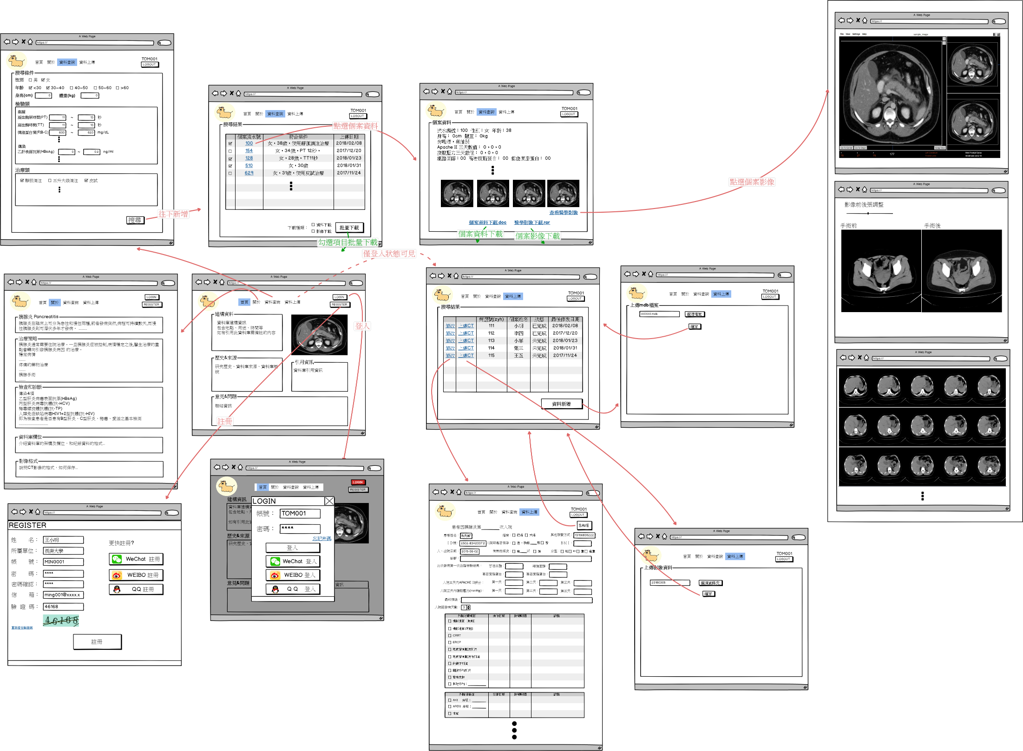

Slide 35
Design Issues
Response time
Help facilities
Error handling
Menu and command labeling
Application accessibility
Internationalization

Slide 36
Design Evaluation Cycle

Slide 37
設計規格編號溯源
功能編號 | 功能名稱 | 功能說明 | 使用者
Fn-A2-101 | 訪談時間設定 | 設定年度訪談時間是在入住週年前多久(月)需執行訪談、可訪談之時間、訪談時間長度及各訪談類別及有效工作時間設定 | 督導
Fn-A2-102 | 監控規則設定 | 設定監控作業完成之時間及順序 | 督導
Fn-A2-103 | 提醒設定 | 設定提醒時間、對象及提醒用語 | 督導
 | 高危評量因子 | 定訂高危評量因子各問項所需答案之運算公式 | 系統管理者
 | 高危訪談設定 | 設定量表有效工作時間、高危訪談執行之循環及監控所需之月份 | 督導
Fn-A2-120 | 量表參數設定 | 需訪談之量表及內容設定，包含量表內容設計、標準值設定、量表異常設定與訪談頻率設定 | 督導
Fn-A2-121 | 量表設定 | 設定需訪談之量表及量表標準判別方式 | 督導
Fn-A2-122 | 量表內容設計 | 針對所需訪談之量表設計其內容及各問項、選項之得分 | 督導

Slide 38
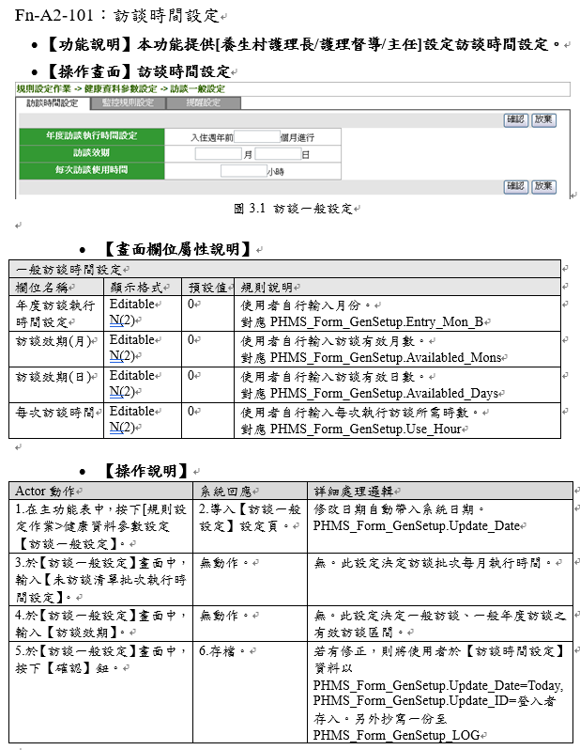

Slide 39
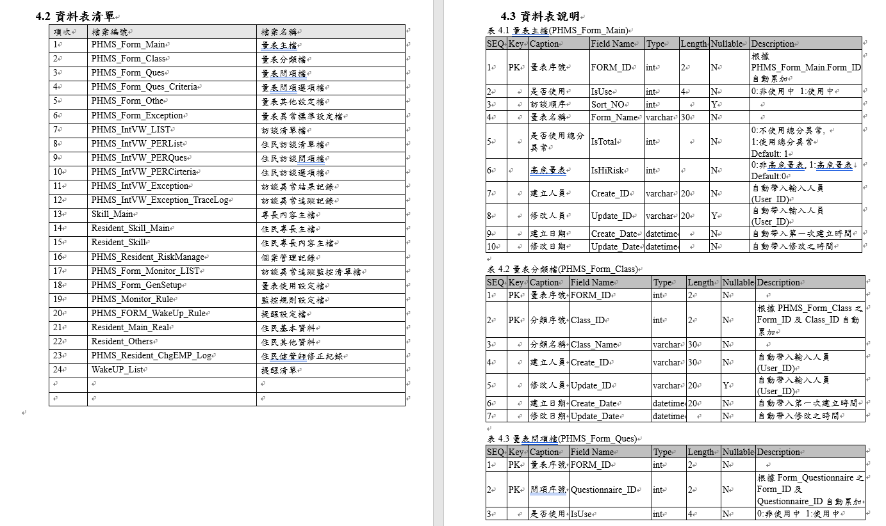

Slide 40
THANKS.

